Slide 1
N-4 Solid propulsion
Week 9 progress Report

Slide 2
Week’s Objectives
1. [#11] Nozzle Fabrication.
2. [#9] Mandrel fabrication
3. [#17] Liner fabrication
4. [#14] Bulkhead fabrication
5. [#20] Housekeeping
6. [#] Cutting of 1 grain casing

Slide 3
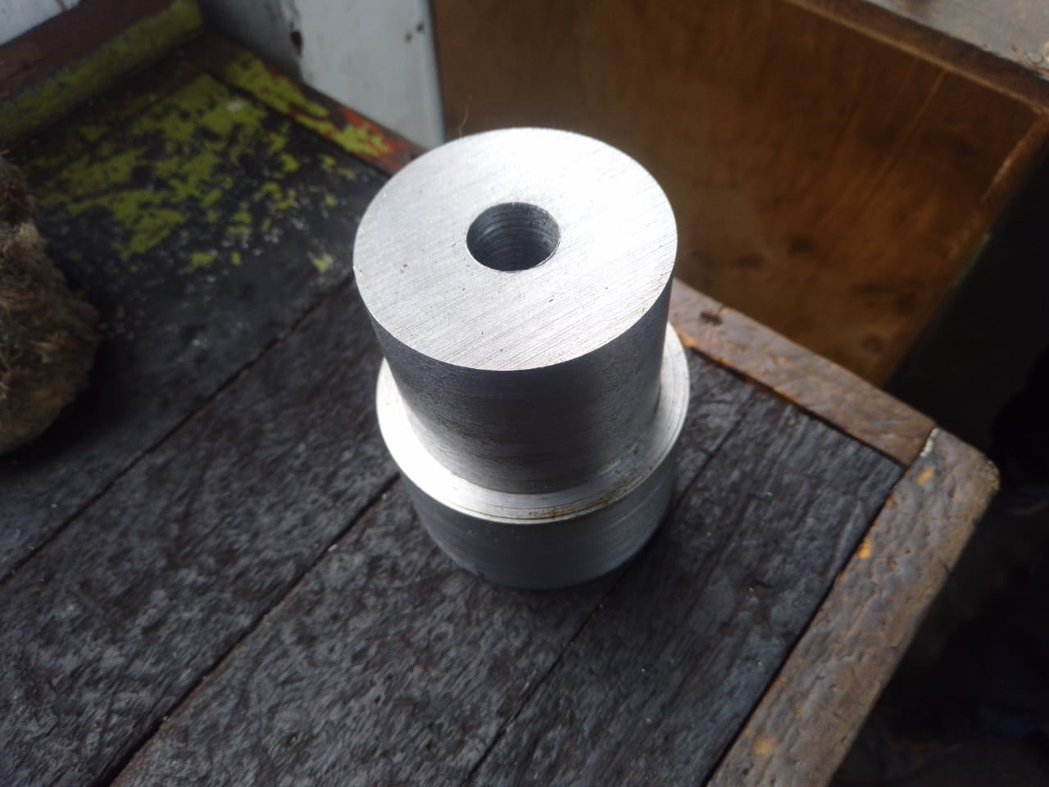
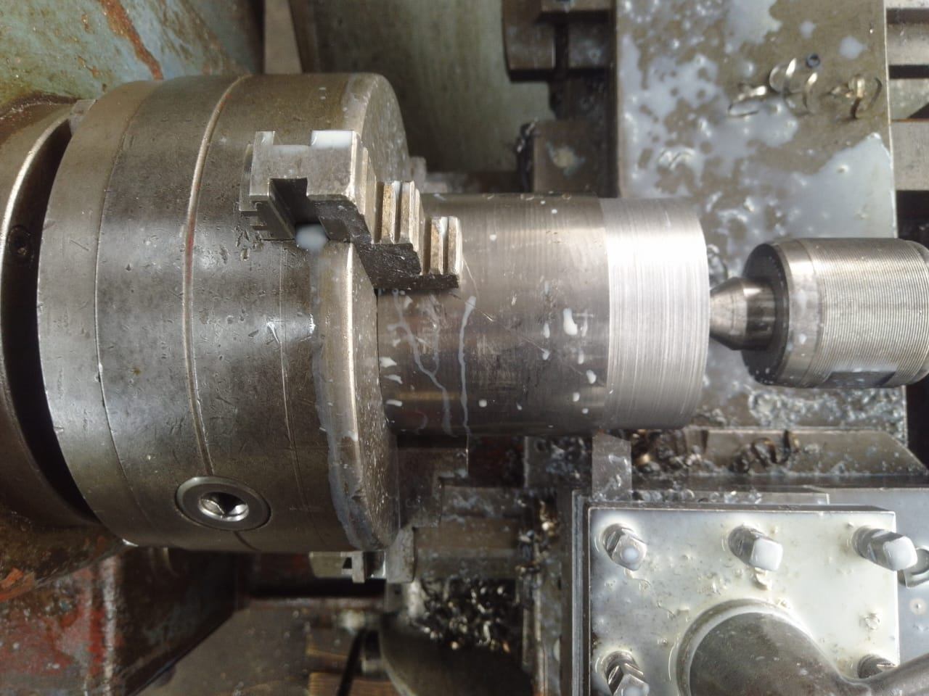
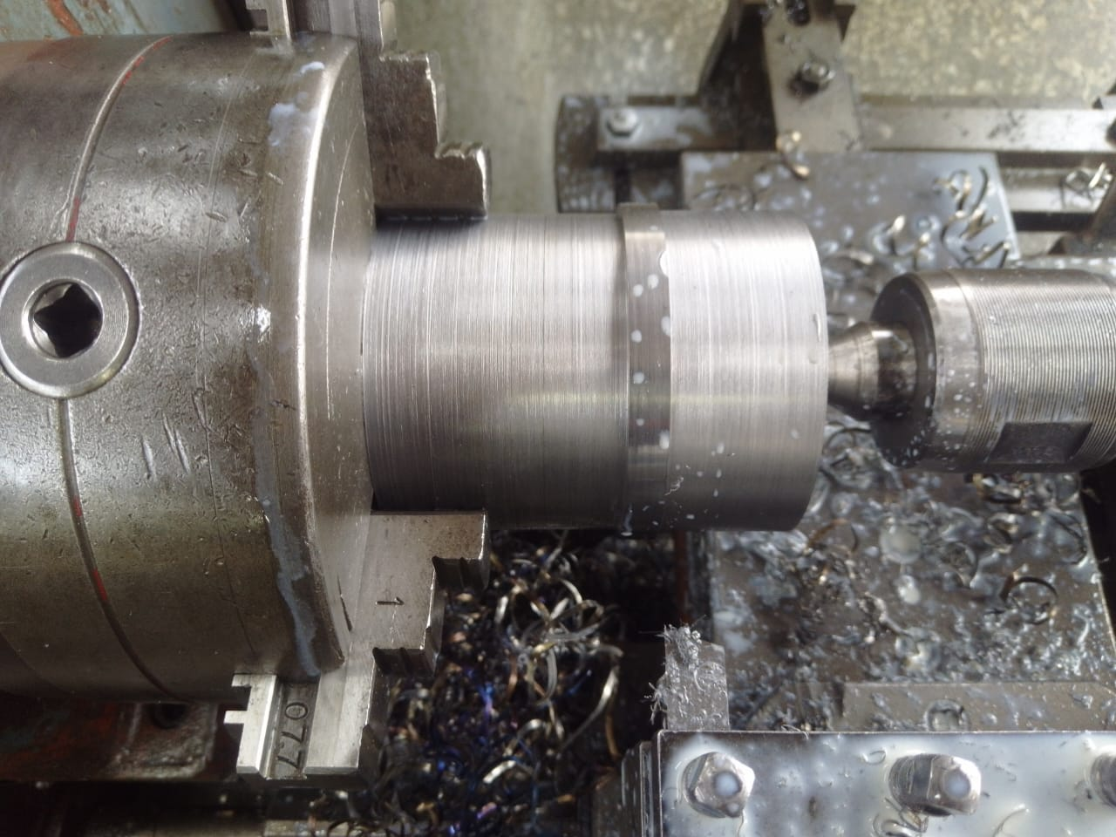
[#11] Nozzle Fabrication.
Facing to reduce the length to 115mm
Turning to reduce the Dout to 92mm
Drilling done

Slide 4
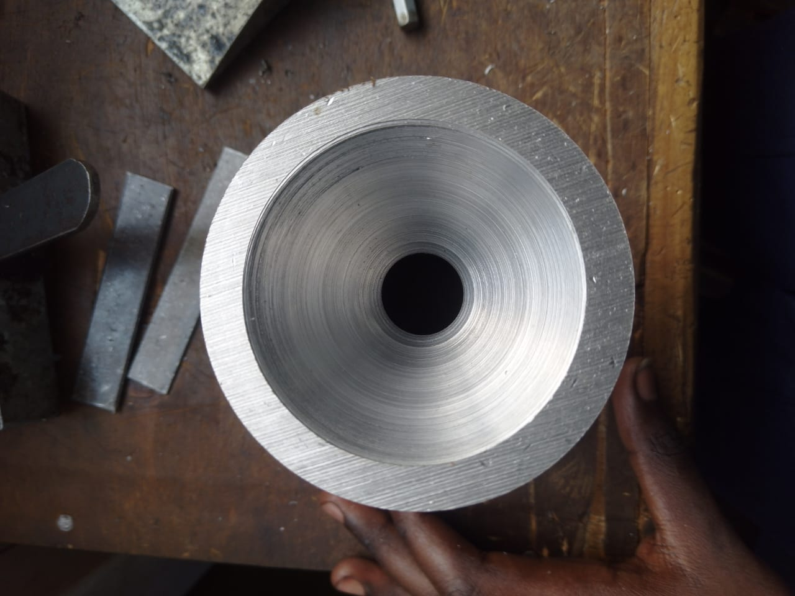
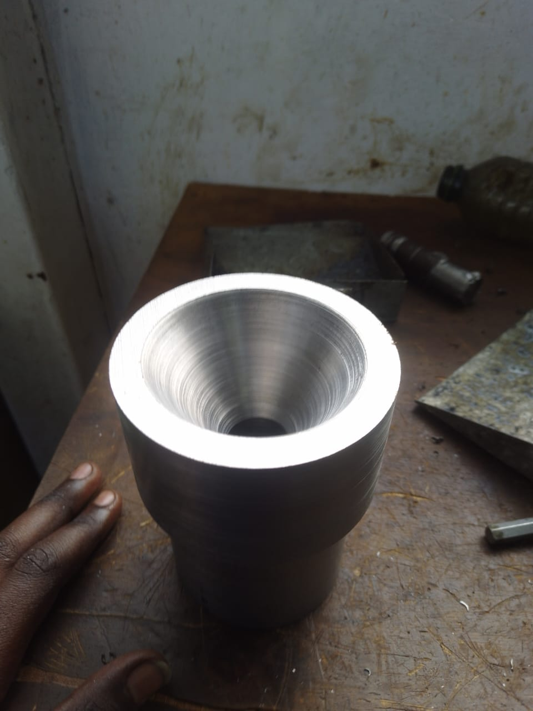
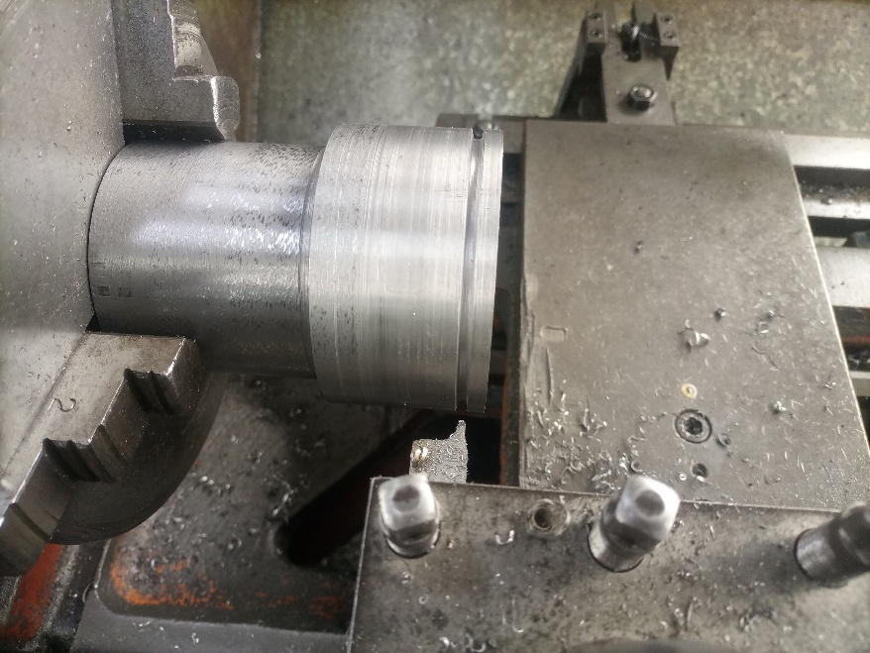
[#11] Nozzle Fabrication (cont)
Machine the converging angle = 30 deg
Machine the diverging angle =15 deg
O-ring groove machining

Slide 5
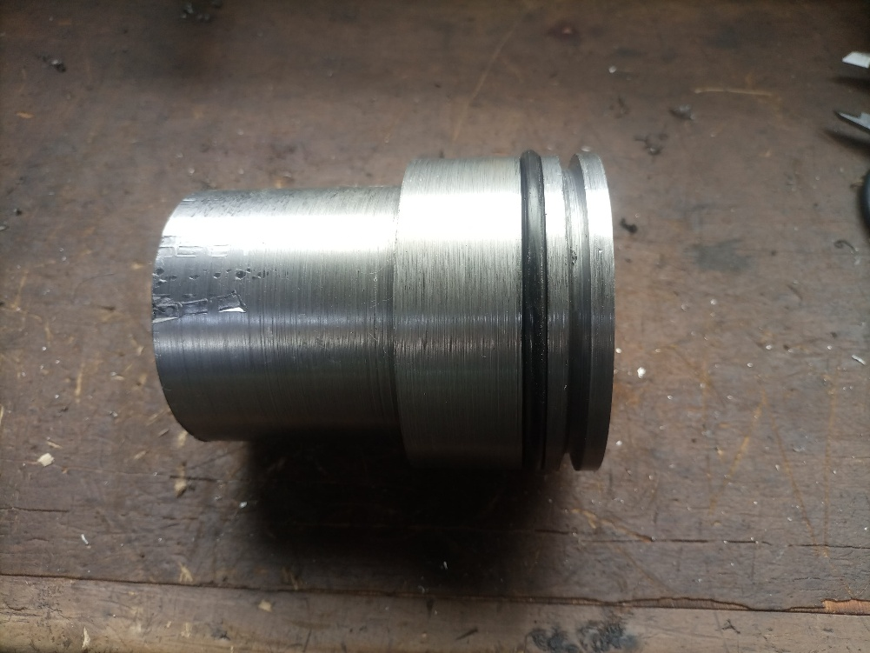
[#11] Nozzle Fabrication (cont)
Completed Nozzles fab – 3 done
Inventory check:
3 Nozzles previously done- dimensions to be rechecked and nozzles labelled.
Total available nozzles: 6
Remaining Mild steel stock=2
Finalized Nozzle

Slide 6
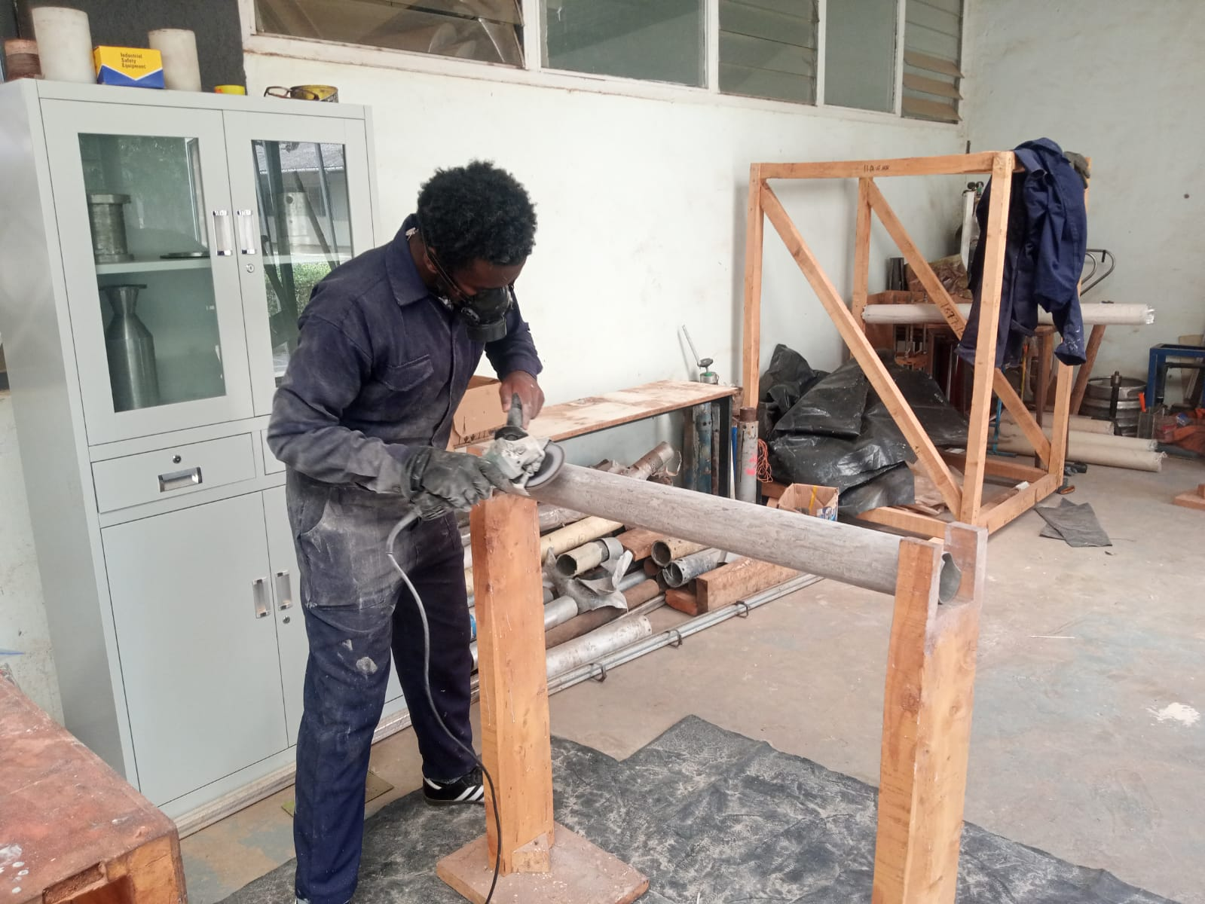
[#9] Mandrel fabrication
Sanding Dout to 86mm

Slide 7
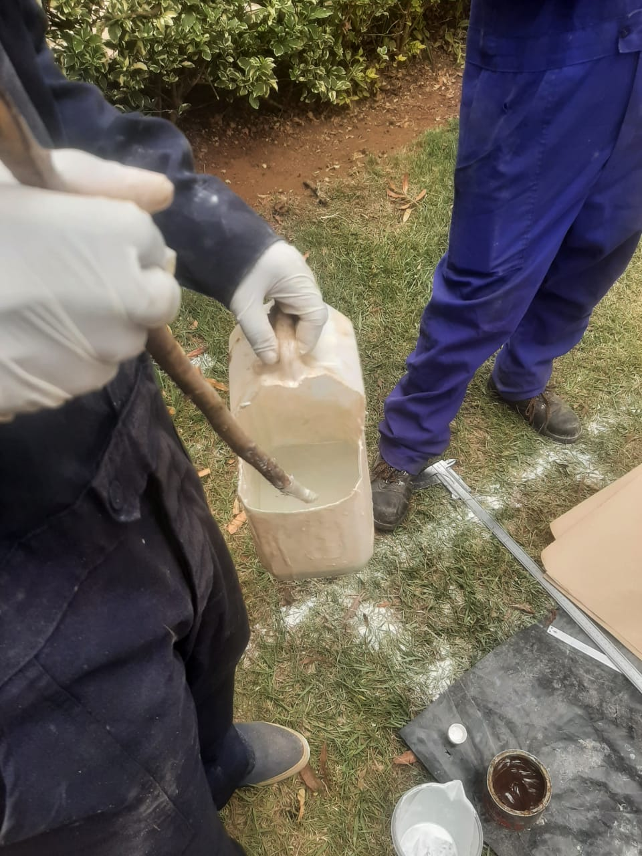
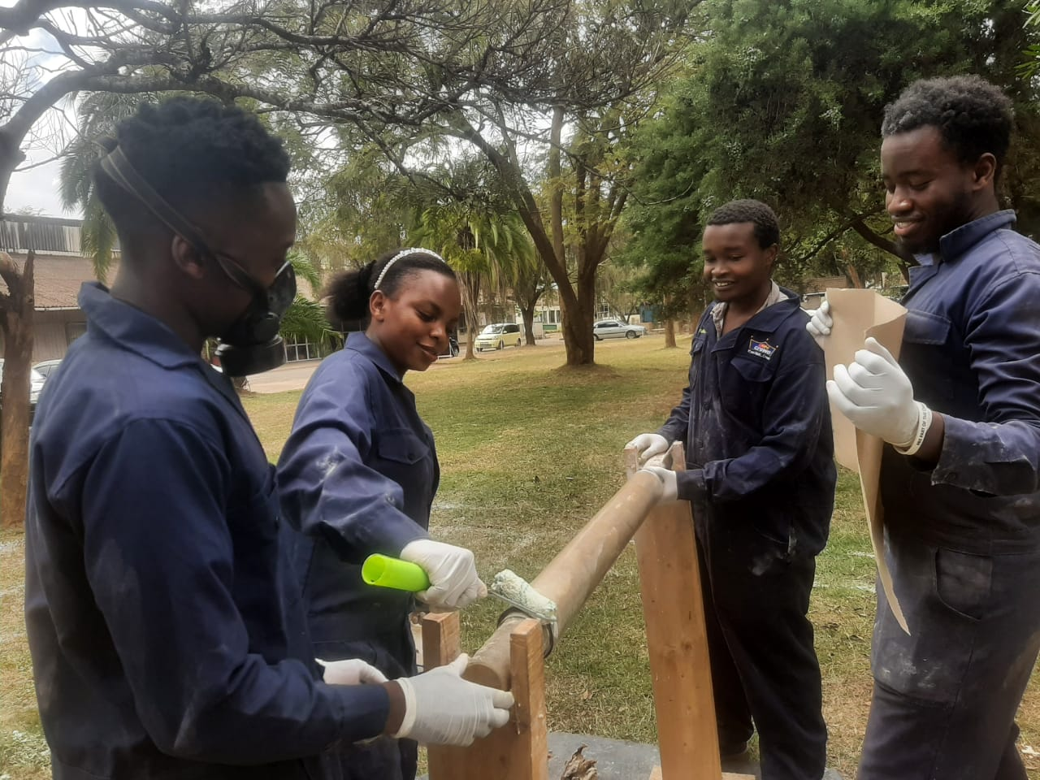
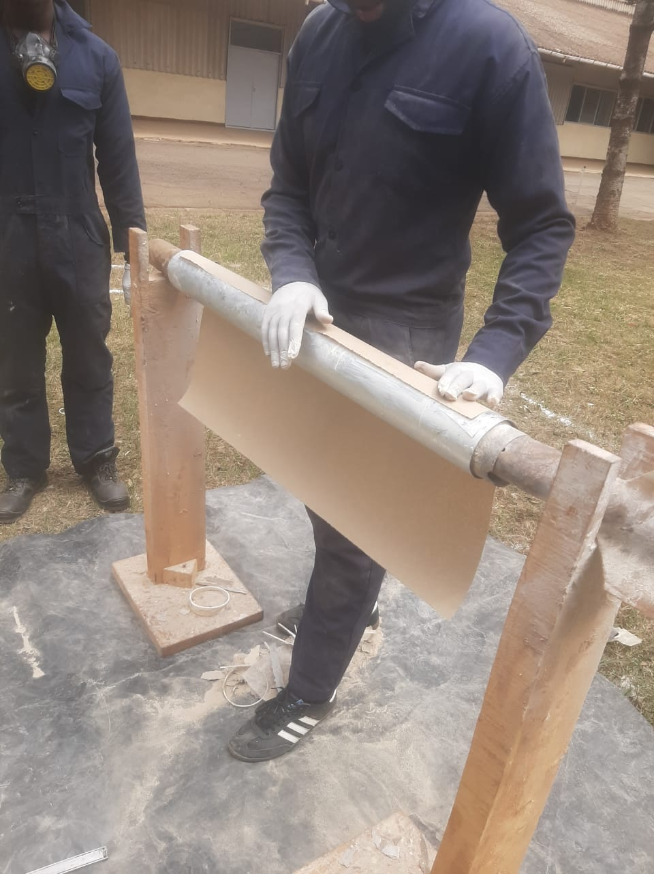
[#17] Liner fabrication
Epoxy to hardener ratio: 50 : 1
Liner left to cure for 3 days
Layering of craft paper

Slide 8
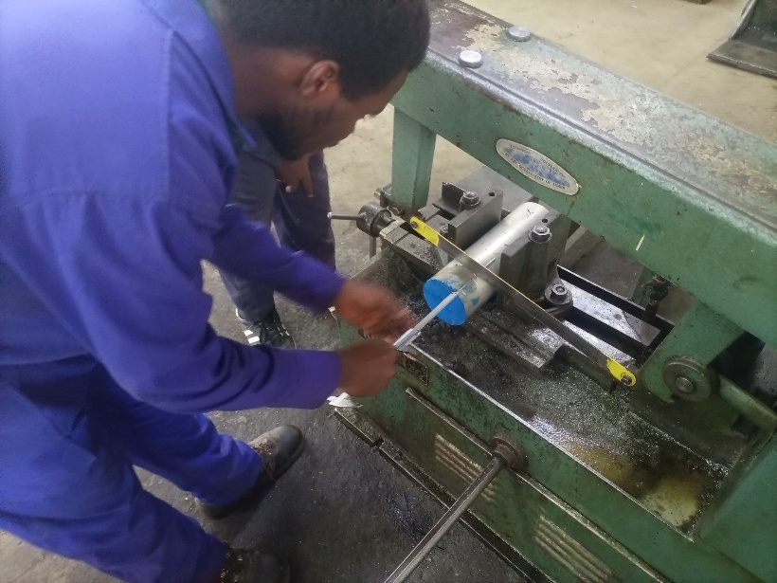
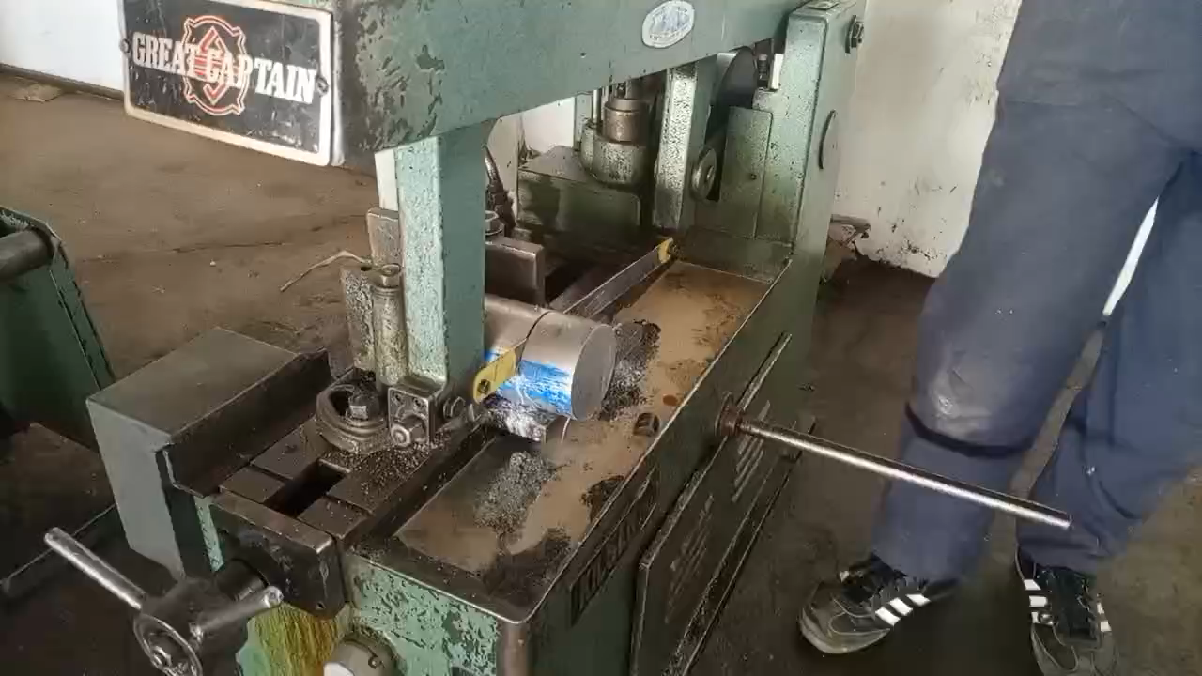
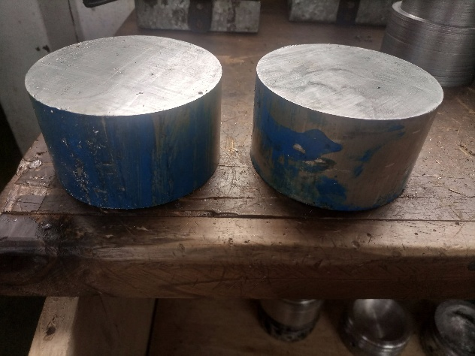
[#14] Bulkhead fabrication
Two- cut work pieces available
one- cutting ongoing
Total cut =3
Taking measurement before cutting
Cutting using power hacksaw

Slide 9
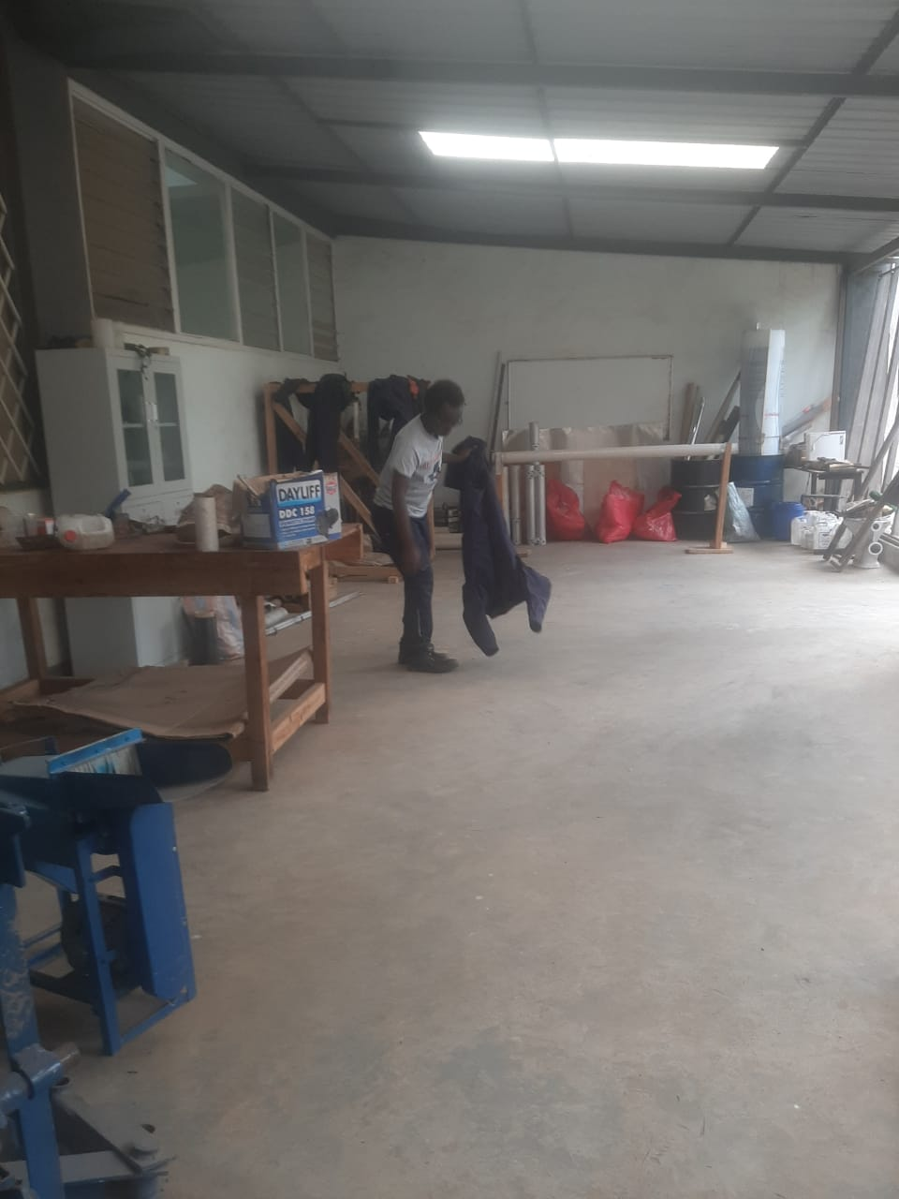
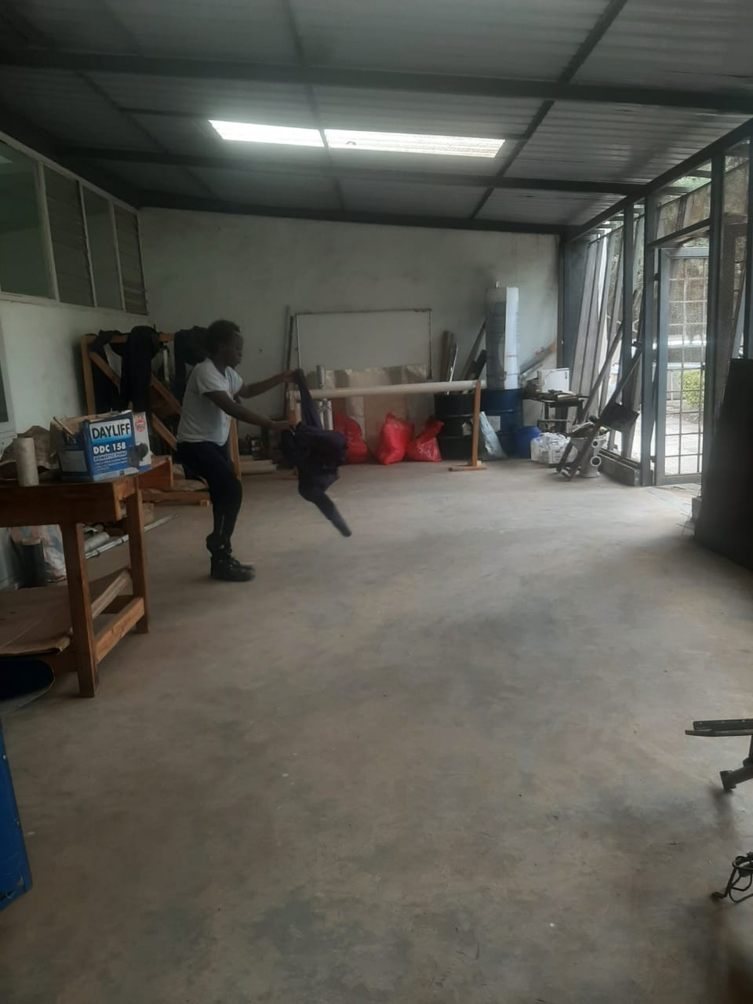
[#20] Housekeeping
Exhibition hall, cleaned✅

Slide 10
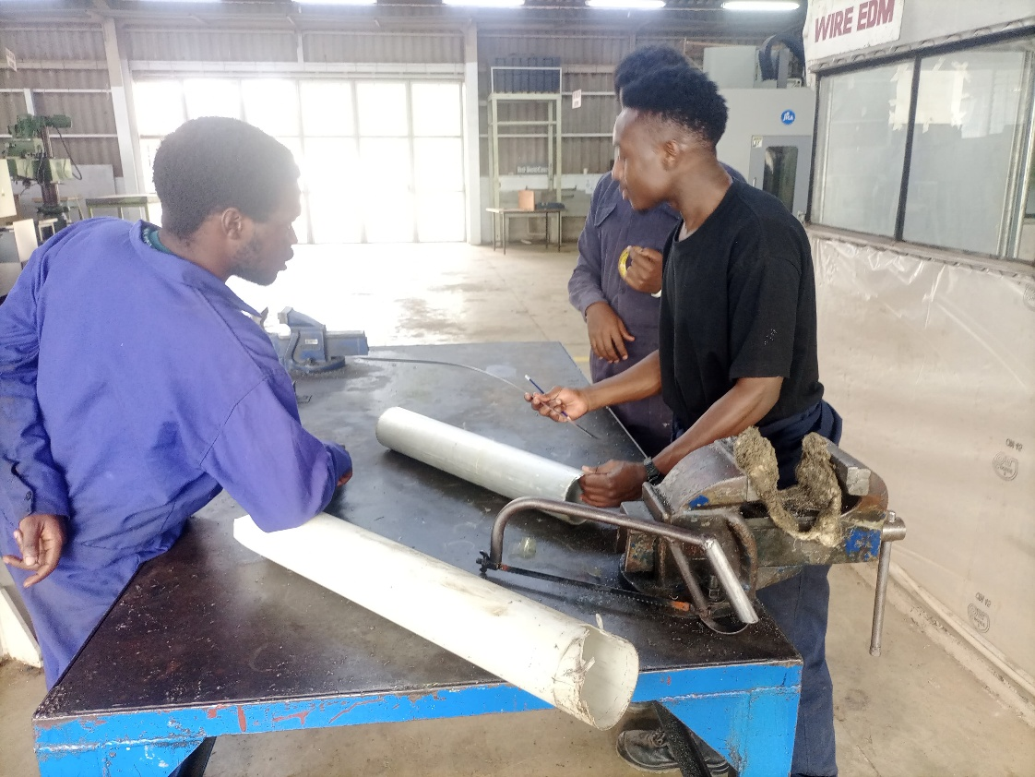
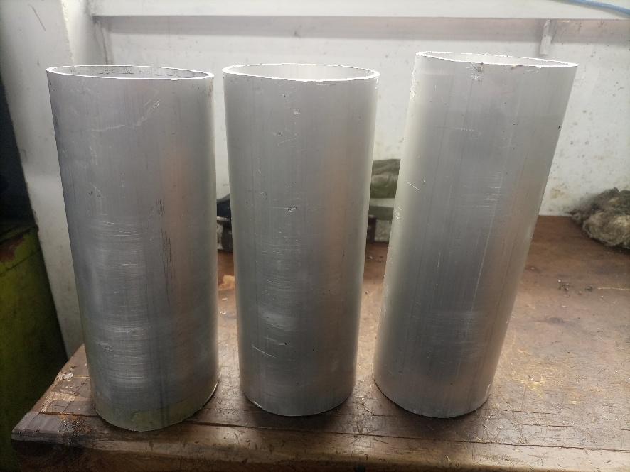
Cutting of 1 grain casing
3 pieces cut
Previous casing were deformed

Slide 11
Challenges
Induction cooker repair still ongoing – delay in cooking 1 grain to test curing setup

Slide 12
Next week’s Objectives
1 [#15] Gain preparation – 1 grain
2 [#21] Igniter design and fabrication
3[#14] Bulkhead fabrication
4[#11] Nozzle Fabrication
5[#17] Fabrication of liner- cutting to specific length required for 1 grain

